Slide 1
File System & IO System

Slide 2
Outline
File systems
File concept & access methods
Directory structure
File system implementation
Disk space allocation
Free space management
I/O systems (quick review)

Slide 3
File concept & access methods
File system: Organization of non-volatile memory
Allow user to create, maintain, access, modify and delete files.
Data is regarded as a set of files
file is an abstraction of storage unit containing
a logical set of data
descriptive information about the file (attributes)
Files are grouped into directories
enable file identification & retrieval

Slide 4
File concept & access methods
File Structure：Consists of a number of records
a record is the finest granularity for accessing data
can be a “byte” or a “complicated object”

Slide 5
File concept & access methods
File Attributes: Used to simplify file identification and access
name
type: e.g. executable module, ASCII text, ...
location: pointer to where the data is stored
size
protection: e.g. read/write privileges
time & dates: e.g. of creation, last modification & use
user: “owner” of file

Slide 6
File concept & access methods
File Operations
Create and Delete
allocate and deallocate space
add/delete the file to/from the directory

Slide 7
File concept & access methods
File Operations
Open and Close
reduce directory searching
open
locates a file in the directory structure
stores this information in the OS open file table
returns a handle to the file
usable for reads, writes, etc.
close: removes the file table entry

Slide 8
File concept & access methods
File Operations
Read, Write, and Reposition
depends on the file structure
sequential operations
OS maintains a file position pointer
read reads from this position
write overwrites starting at this position
reposition changes the file position pointer

Slide 9
File concept & access methods
File Operations
Other operations
Append to an existing file
Copy a file

Slide 10
File concept & access methods
File Types
Provide means of interpreting file contents
can be left completely to the application program
OS typically provides support for a minimal set of types

Slide 11
File concept & access methods
File Types
Three ways of associating file types
OS maintains file type information
e.g. Unix executable which indicates a binary object module
names indicate types
typically expressed via an extension (e.g. file-name.type)
convenient for user and application programs
OS can associate programs with file extensions (e.g., Word with .doc)
internal to the file
e.g. a magic numbers convention

Slide 12
File concept & access methods
File Storage and Access Models
Files are stored in (persistent) secondary storage
Stored as data chunks called blocks
Sectors on disks
Blocks are usually fixed size
File access models
sequential: read/write (fid, buf)
direct: read/write (fid, record#, buf)
indexed: read/write (fid, record-key, buf)
Notes:
索引(indexed)文件访问方式，参见操作系统概念第七版 10.2.3 其他访问方式

Slide 13
Outline
File systems
File concept & access methods
Directory structure
File system implementation
Disk space allocation
Free space management
I/O systems (quick review)

Slide 14
Directory structure
Directories
A logical way of organizing the files
a “symbol table” for translating file names into its attributes
to expedite access to files
to implement access privileges easily
Notes:
expedite 加速完成

Slide 15
Directory structure
Tree-structured Directories
The directory is a tree of unlimited depth
each node is either a file or a (sub)directory
each file/directory is identified by a path-name
from the root (an absolute pathname)
from a specified directory (a relative pathname)
Notes:
画tree图说明 路径（仍有学生不明白相对路径的写法）

Slide 16
Directory structure
Tree-structured Directories
Protection information specified at each node in the path
for files: readable, writeable, executable
for directories: visible, writeable, searchable
UNIX scheme:
Three fields (each with three bits): owner, group, others
drwxr-xr-x 2 vijayk None 0 Apr 8 13:03 a-dir
-rw-r--r-- 1 vijayk None 0 Apr 8 13:03 a-file
Notes:
画tree图说明 路径（仍有学生不明白相对路径的写法）

Slide 17
Directory structure
Non-tree Directory Structures
Limitations of tree-structured directories:
Restricted file sharing
each file has a single name and belongs in a single directory
Generalizations of trees
directed acyclic graphs (DAGs)
(unrestricted) directed graphs
Basic idea
allow a file or directory to be in multiple directories
Notes:
拓扑排序-有向无环图（DAG, Directed Acyclic Graph）

Slide 18
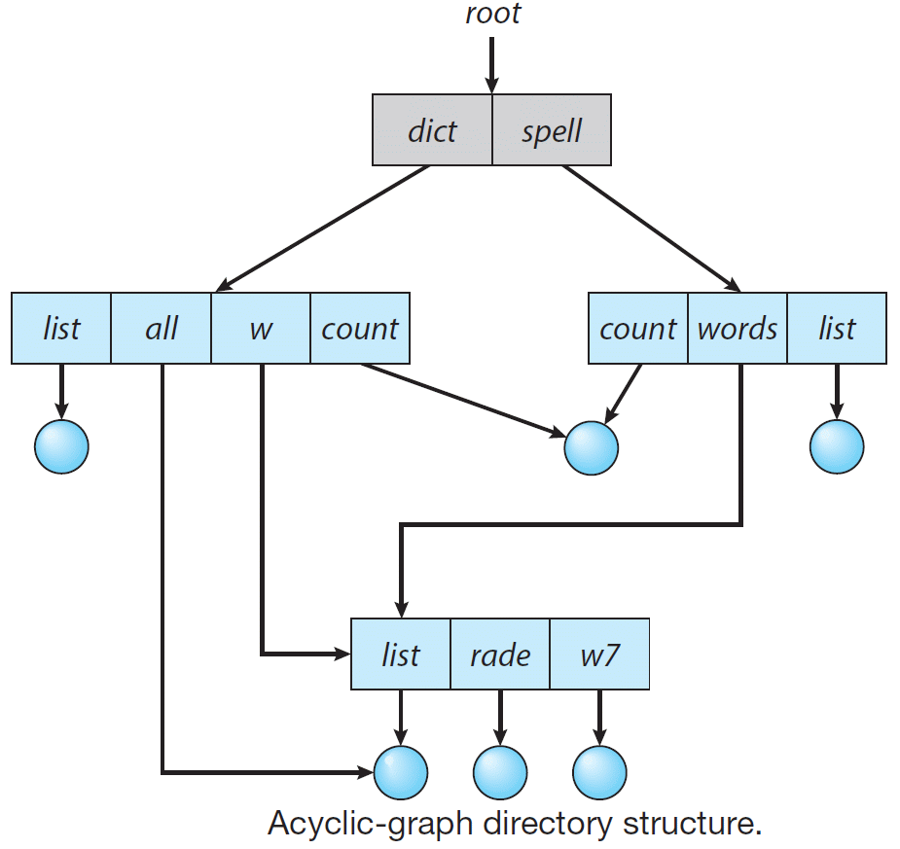
Directory structure
Non-tree Structured Directories: Example

Slide 19
Directory structure
Problem
The same file may be referred to by multiple names
How do we maintain consistency of the directory information?
E.g., file size, update time, etc.
Notes:
画图说明Hard link 和 soft link。
Hard link 和 soft link的区别：硬链接原文件＆链接文件公用一个inode号，说明他们是同一个文件，而软链接原文件＆链接文件拥有不同的inode号，表明他们是两个不同的文件； 在文件属性上软链接明确写出了是链接文件，而硬链接没有写出来，因为在本质上硬链接文件和原文件是完全平等关系；链接数目是不一样的，软链接的链接数目不 会增加；文件大小是不一样的，硬链接文件显示的大小是跟原文件是一样的，而这里软链接显示的大小与原文件就不同了。

Slide 20
Directory structure
Two approaches
Maintain a single copy of the file
each parent directory contains pointers，called links in Unix
hard links: a new (replicated) directory entry
OS keeps these entries consistent
soft links: a directory entry that points to the original
pointers must be transparent to application programs
Maintain explicit copies
OS must update all copies to reflect the latest state
Notes:
画图说明Hard link 和 soft link。
Hard link 和 soft link的区别：硬链接原文件＆链接文件公用一个inode号，说明他们是同一个文件，而软链接原文件＆链接文件拥有不同的inode号，表明他们是两个不同的文件； 在文件属性上软链接明确写出了是链接文件，而硬链接没有写出来，因为在本质上硬链接文件和原文件是完全平等关系；链接数目是不一样的，软链接的链接数目不 会增加；文件大小是不一样的，硬链接文件显示的大小是跟原文件是一样的，而这里软链接显示的大小与原文件就不同了。

Slide 21
Directory structure
Other Problems
Shared files
problem with deleting shared files
solutions
leave links dangling (e.g. soft links in Unix)
the links are checked (and generate errors) when accessed
maintain a reference count of links to a file/directory
delete only when count is zero (e.g., hard links in Unix)
Notes:
traversal operations 遍历操作

Slide 22
Directory structure
Other Problems
Directory cycles
adding links can create cycles
can happen unless each directory creation is checked
problems with directory search
solutions
do nothing (Unix)
make sure that directory traversal operations check for cycles
Notes:
traversal operations 遍历操作

Slide 23
Outline
File system interface
File concept & access methods
Directory structure
File system implementation
Disk space allocation
Free space management
I/O systems (quick review)

Slide 24
File system implementation
Overall structure
uses the directory structure to translate user file commands into requests expected by the file-organization module [responsible for caching and other optimizations]
deals with logical blocks and logical devices [includes the free-space manager which tracks and allocates free disk blocks]
deals with blocks and physical devices: [issues commands to the device drivers]
device drivers and interrupt handlers to transfer information between memory and the disk system

Slide 25
Outline
File system interface
File concept & access methods
Directory structure
File system implementation
Disk space allocation
Free space management
I/O systems (quick review)

Slide 26
Disk space allocation
Three types of information stored on the disk
data blocks:
file descriptors:
name, access privileges, usage times, ...
storage allocation information (sometimes called a superblock)

Slide 27
Disk space allocation
Disk block allocation
disk blocks are “numbered”
usually a simple function of <platter #, surface #, cylinder #, sector #>
sometimes allocated in multiples to reduce management overhead
commonly used schemes
Contiguous allocation
Linked allocation
Indexed allocation

Slide 28
Disk space allocation
Scheme 1: Contiguous Allocation
Similar to contiguous memory allocation
files occupy a sequence of "blocks" of disk
a file occupies blocks b, b+1, ... b+(n-1)
the file descriptor stores b and its length (in bytes)
mapping from logical to physical: Logical address/Block Size
Quotient: block number
Remainder: block offset
Finding disk space
methods such as first-fit, best-fit, worst-fit
Problems
external fragmentation
compaction would work but involves high-overhead disk operations
need a good estimate of the file size at allocation time; too small: potentially expensive copying is needed to relocate it as it grows; too large: internal fragmentation

Slide 29
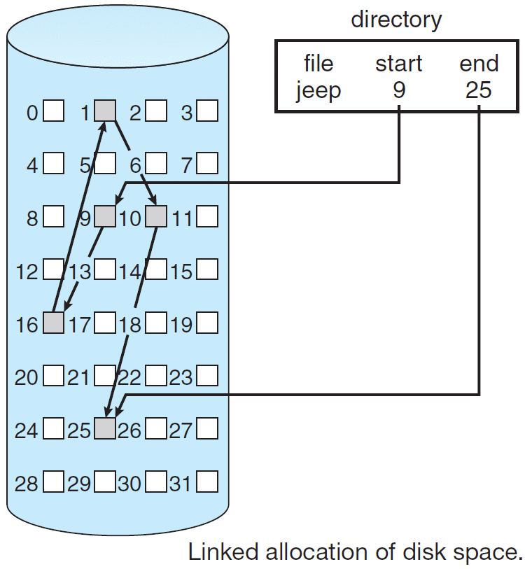
Disk space allocation
Scheme 2: Linked Allocation
The file consists of
arbitrary sequence of disk blocks
a set of pointers from each block to the next
Initially, the file descriptor
contains a null pointer when the file is empty
Extending the file is done by
adding any free block
modifying the pointers
No problem with external fragmentation
Where are the pointers stored?

Slide 30
Disk space allocation
Pointer Storage for Linked Allocation
Store the pointer in the blocks
very slow random/direct access
Store the pointers separately
e.g. MSDOS File Allocation Table (FAT)
uses a contiguous array A of indices (stored in a fixed place on the disk)
if block i is followed by block j in a file， A[i] = j
array A can be stored in memory during use
or partially stored (cached)
allows (slow) random access to file by scanning array

Slide 31
Disk space allocation
Scheme 3: Indexed Allocation
Each file has an index table A
The i ^{th} block of the file is in block A[i]
can be cached for rapid access
Pros
supports direct access
has no external fragmentation
Cons
for small files, index block space may be wasted

Slide 32
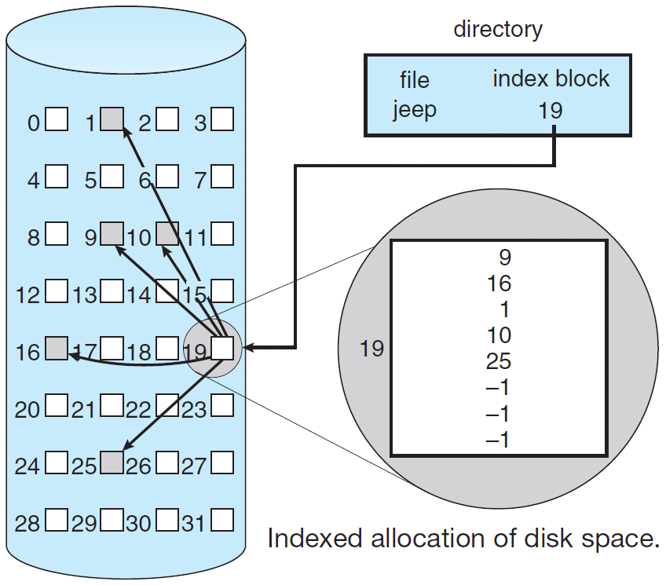
Disk space allocation
Example of Indexed Allocation

Slide 33
Outline
File system interface
File concept & access methods
Directory structure
File system implementation
Disk space allocation
Free space management
I/O systems (quick review)

Slide 34
Free-space Management
Keep track of which disk blocks are free, should be fast
Bit vectors
Linked lists
Grouping
Counting

Slide 35
Free-space Management
Bit vectors(位向量，位图)
one bit per block: 1 means block is free; 0 means block is in use
finding a free block
the OS scans the vector for the first 1
sets it to 0 upon allocation
improvements
some processors support special instructions
return the offset in a word where the first 1 occurs
circular search (start from previous position)
bit vectors may be very large
if maintained on disk, access is slow

Slide 36
Free-space Management (cont’d)
Linked lists
connect all the available blocks
a separate list
the file allocation table (FAT) can do this for free
one pointer in a free block which points to the next
allocation & deallocation are slow

Slide 37
Free-space Management (cont’d)
Grouping
a linked list of free blocks full of pointers
used in Unix

Slide 38
Free-space Management (cont’d)
Counting
rather than a list of blocks, maintain a count of contiguous free blocks
point to the beginning of the "run" of free blocks and the number
a large number of free blocks can be found quickly
useful when allocations are done in groups

Slide 39
Outline
File system interface
File concept & access methods
Directory structure
File system implementation
Disk space allocation
Free space management
I/O systems (quick review)

Slide 40
I/O systems
I/O hardware
I/O devices sit on a bus
Device controllers
Controllers appear to the OS as I/O ports and associated registers
Handshaking between the host and the device controller
Polling
Interrupts to make efficient use of CPU resources
Offloading of CPU work to a DMA controller for large transfers

Slide 41
I/O Interface
Goal: Standard, uniform treatment of I/O devices
I/O system calls encapsulate device behaviors in generic classes
Device-driver layer hides differences among I/O controllers
Devices differ among several dimensions
character-stream (keyboards, mice) or block (disks) or network devices
sequential or random-access
synchronous or asynchronous
sharable or dedicated
read-write, read-only, or write-only
Device driver exports a standard interface (mapping to system calls)
OSes typically provide a back-door to directly access device driver
E.g., UNIX ioctl system call
Notes:
ioctl用于向设备发控制和配置命令，有些命令也需要读写一些数据，但这些数据是不能用read/write读写的，称为Out-of-band数据。也就是说，read/write读写的数据是in-band数据，是I/O操作的主体，而ioctl命令传送的是控制信息，其中的数据是辅助的数据。例如，在串口线上收发数据通过read/write操作，而串口的波特率、校验位、停止位通过ioctl设置，A/D转换的结果通过read读取，而A/D转换的精度和工作频率通过ioctl设置。

Slide 42
Kernel I/O Subsystem
Provides a common set of services and maintains kernel data structures
Scheduling: I/O request ordering via per-device queue
For performance and fairness
e.g., disk request scheduling affects seek overheads
Buffering: Store data in memory while transferring between devices
to cope with device speed/device transfer size mismatch
Double buffering permits overlap

Slide 43
Kernel I/O Subsystem (cont’d)
Caching: Fast memory holding copy of data
key to performance
E.g., file caches
Spooling: Merges requests for a device
if device can serve only one request at a time (e.g., printing)
System call interface permits multiple applications to print concurrently
Request data is put into a common directory
Spooler issues them one at a time to the device
Error handling
recovery from transient errors: e.g. reissuing a disk read request

Slide 44
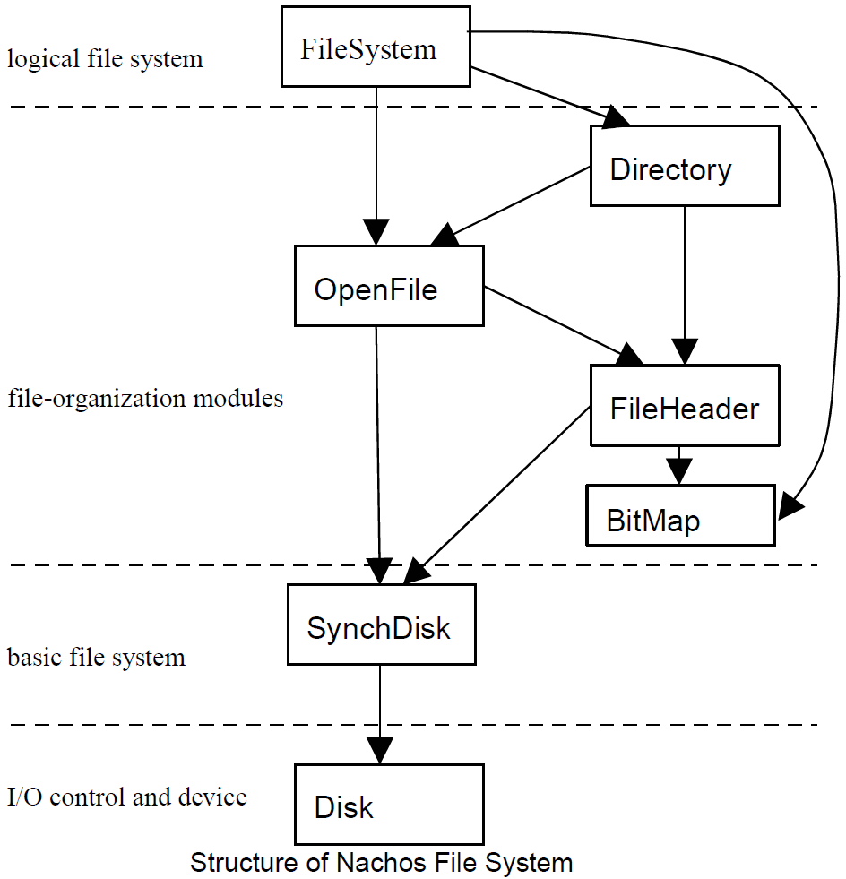
Structure of Nachos File System

Slide 45
Thanks!

